Slide 1
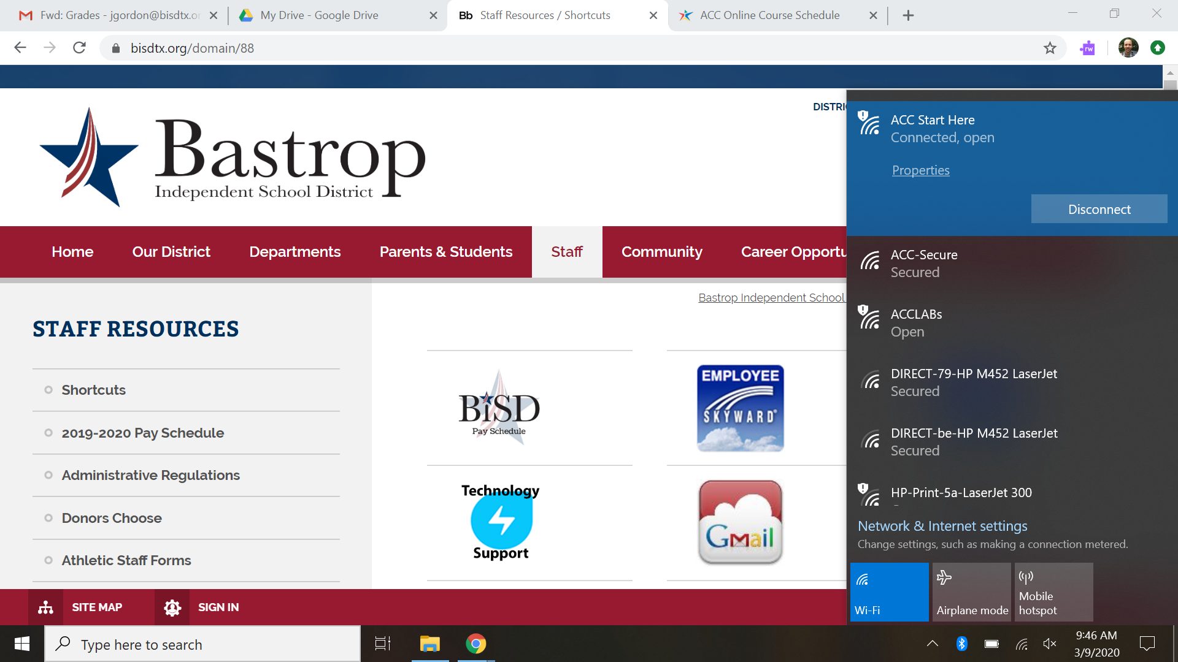
Connect to ACC Start Here (ACC-Secure does not work on CRCA laptops due to security)

Slide 2
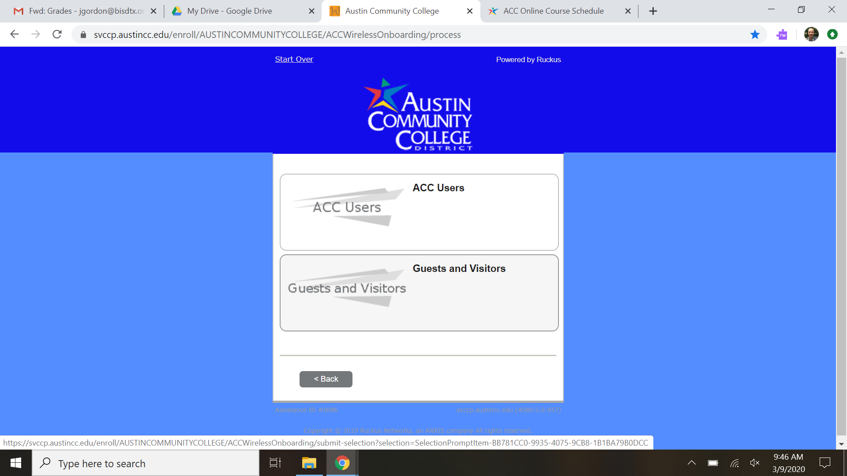
Once connected, go to austincc.edu. It will bring to the sign-in page
Select Guests and Visitors

Slide 3
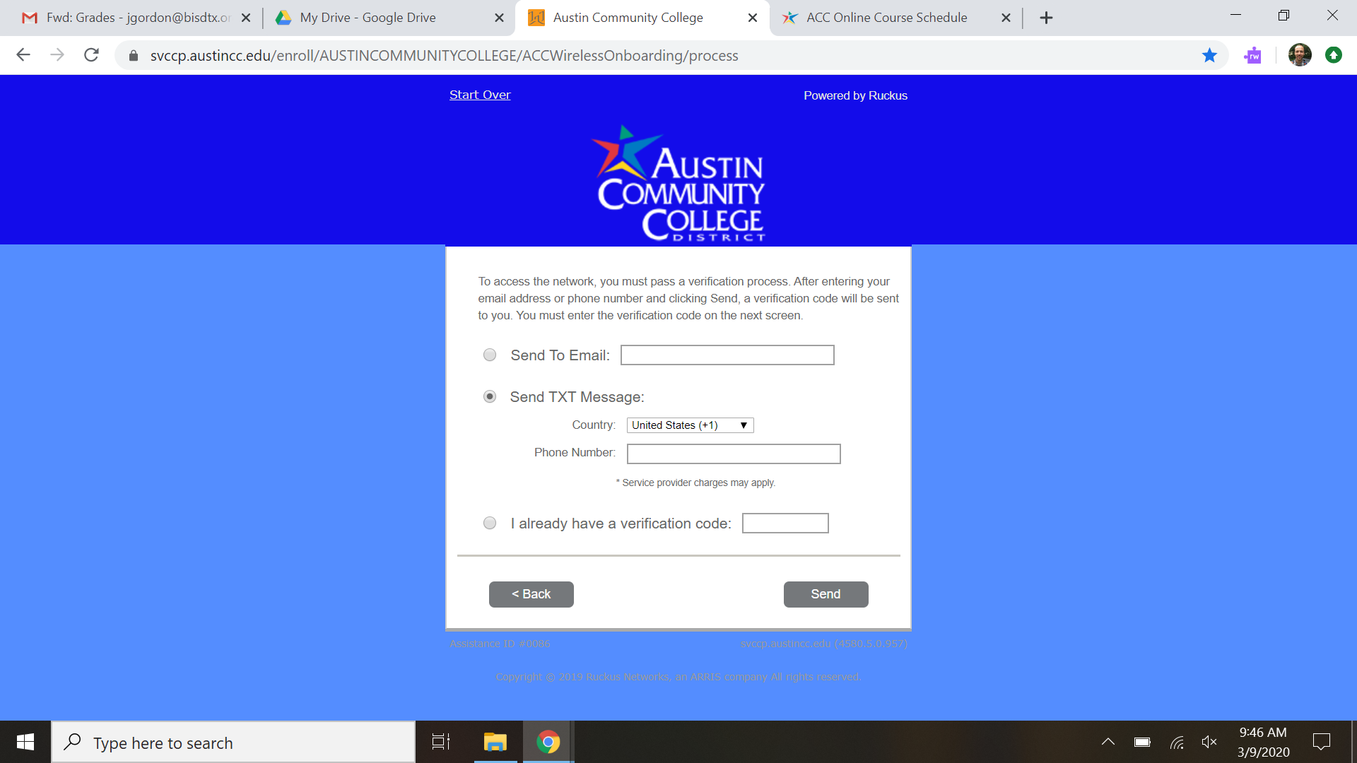
Sign-in using your phone number. They will send you a text message with a four letter code. You are now connected.

